Slide 1
Competition of Social Opinions on Two Layer Networks
Cho Hyunchel , Mahmood Alfan, Wang Lin
2019. 7.30.
Notes:
My topic is Competition of Social Opinions on Two layer Networks.

Slide 2
Contents
1
Background
2
Research Direction
3
Model Introduction
4
Simulation Results
5
Conclusion
Notes:
The Contents order is like this. Background, Research Direction, Model introduction, Simulation results, and conclusion.

Slide 3
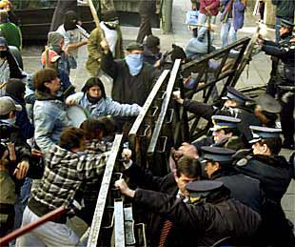

Background
Social conflict
Social conflicts have various forms.
Many previous researches focused on studying interaction on the isolated network.
However, many real-world systems are not isolated, but interacted with many layers.
Ex) civil opinion ↔ congress opinion
Notes:
Background
My research topic is related to social conflict. Social conflicts have various forms.
Many previous researches focused on studying interaction on the isolated network.
However, many real-world systems are not isolated, but interacted with many layers.
For example, civil opinion and congress opinion have their own function, but they are interacted each other.

Slide 4
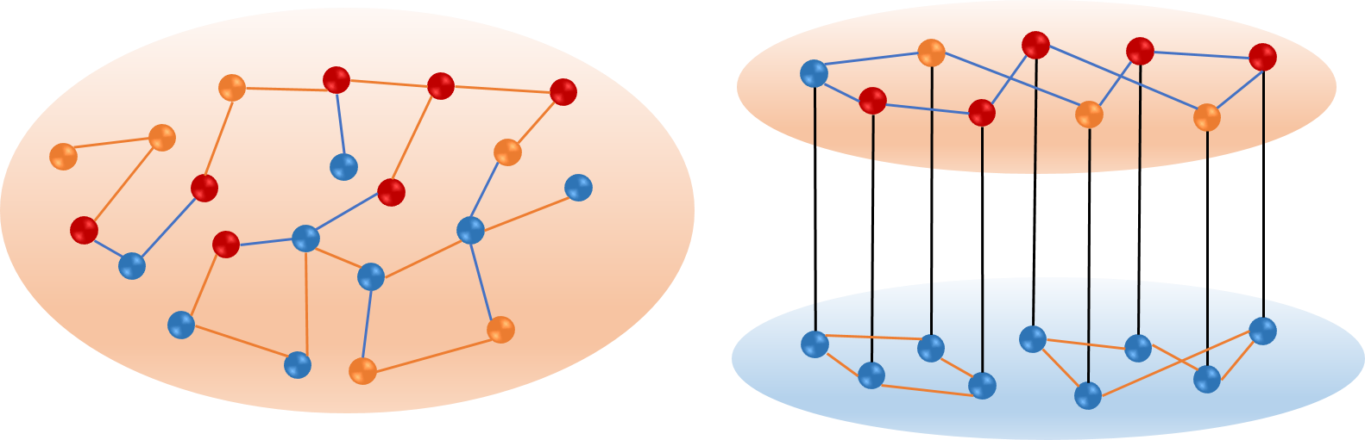
Background
Single layer | Multi layer(interconnected network)
1 dynamics | 2 dynamics (each layer has it own dynamics)
1 parameter | 2 parameter
Internal edge | Internal edge + external edge
We study the competitions on interconnected networks with various structures, and investigate which structure has more probability to perform consensus results.
Notes:
In this research, we focus on social conflict and competition on multilayer network or interconnected network.
Comparing with single layer, interconnected network has 2 dynamics, 2 parameters and include internal edge and external edge.
Here, we study the competition on interconnected networks with various structures, and investigate which structure has more probability to perform consensus results.

Slide 5
Research Direction
Objectives
- Study on impact of multilayer system that each layer has different
dynamics and characteristics
- By changing network structure on two layers, finding out the condition of
consensus and the role of edges on competition network.
① Changing the number of external edges : Finding out the role of external edges
② Changing the number of internal edges : Finding out the role of internal edges
③ Changing the structure of each layer : Finding out the role of network structures
Notes:
Research objectives follows like this.
First, we study on impact of multilayer system that each layer has different dynamics and characteristics.
Second, by changing network structure on two layers,
we find out the condition of consensus and the role of edges on competition networks.
We have 3 modified models.
First, changing the number of external edges. From this model, we can find out the role of external edges.
Second, changing the number of internal edges. Here, we can find out the role of internal edges
Third, changing the structure of each layer. Through this model, the role of network structures would be found out.

Slide 6
Research Direction
Method
Providing the index for measuring consensus
- measuring states : ‘Average State’(AS)
- all parameters : ‘Average State total(AS total)’, ‘Positive Consensus Ratio’(PCR),
‘Negative Consensus Ratio’(NCR)
Analyzing the competition on Random Regular Networks with the indexes
- As the basic model for competition, RR networks are analyzed with all indexes
- Basic features of competition result are derived
- Several properties for measuring consensus are provided
Comparing with the competition on networks of different structures
- By comparing with the basic model(RR networks), it is provided that how the internal
and external edges and network structures affect the consensus of two layers.
- Finally, It would be proved that consensus are controllable by controlling
the number of internal and external edges
Notes:
Next, here is my research method.
First, I provide the indexes for measuring consensus.
To measure the state and consensus, we use Average state index.
To evaluate the consensus results regarding all parameters,
we use 3 kinds of indexes including ‘Average State total, ‘Positive Consensus Ratio’, ‘Negative Consensus Ratio’
Second, Random regular networks are analyzed with these indexes as basic model.
Third, Networks of different structures are compared with Random regular networks.
These comparisons provide how internal and external edges and network structures affect the consensus of two layers.
Finally, it would be proved that consensus are controllable by controlling the number of edges.

Slide 7
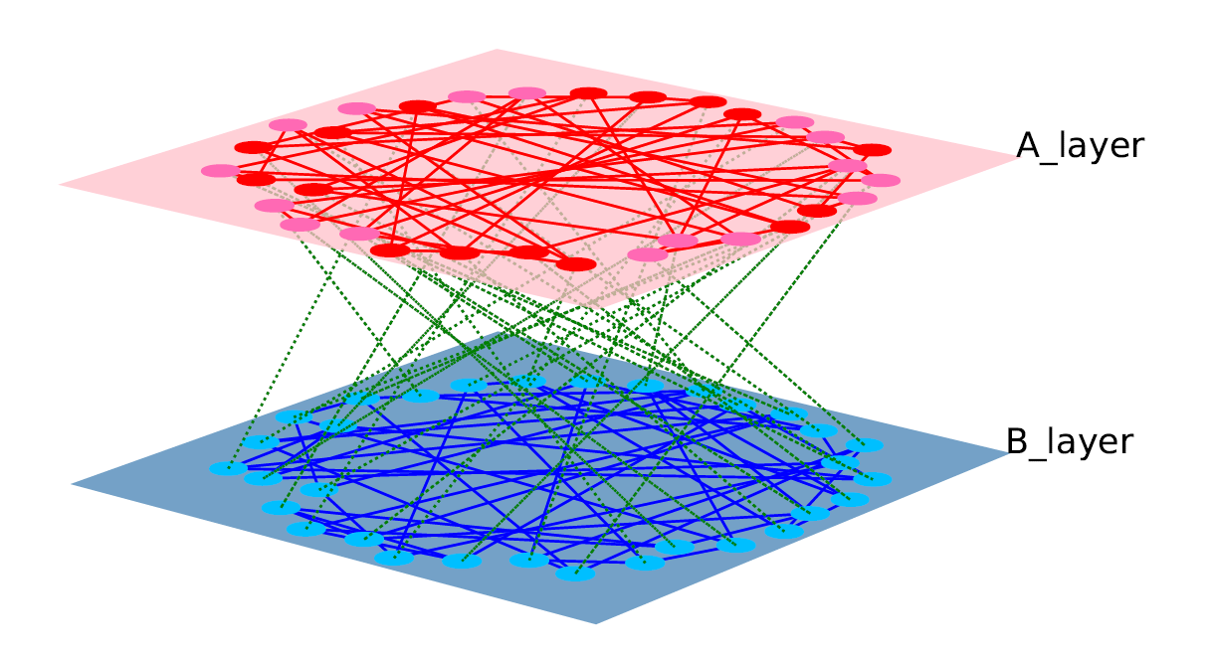
Model Introduction
Social opinion
Mutual interaction
Decision-making
Example case : legalization, vote systems, decision making system
We study the competitions on interconnected networks with various structures, and investigate which structure has more probability to perform consensus results.
Notes:
Model introduction
This figure is simple example for my topic. Layer A is social opinion layer that consists of positive states. And layer B is decision making layer that is made of negative states.
They have mutual interaction each other. In the real world, we can apply for legalization, vote system and decision making system.
Here, we study the competitions on interconnected networks with various structures, and investigate which structure has more probability to perform consensus result.

Slide 8
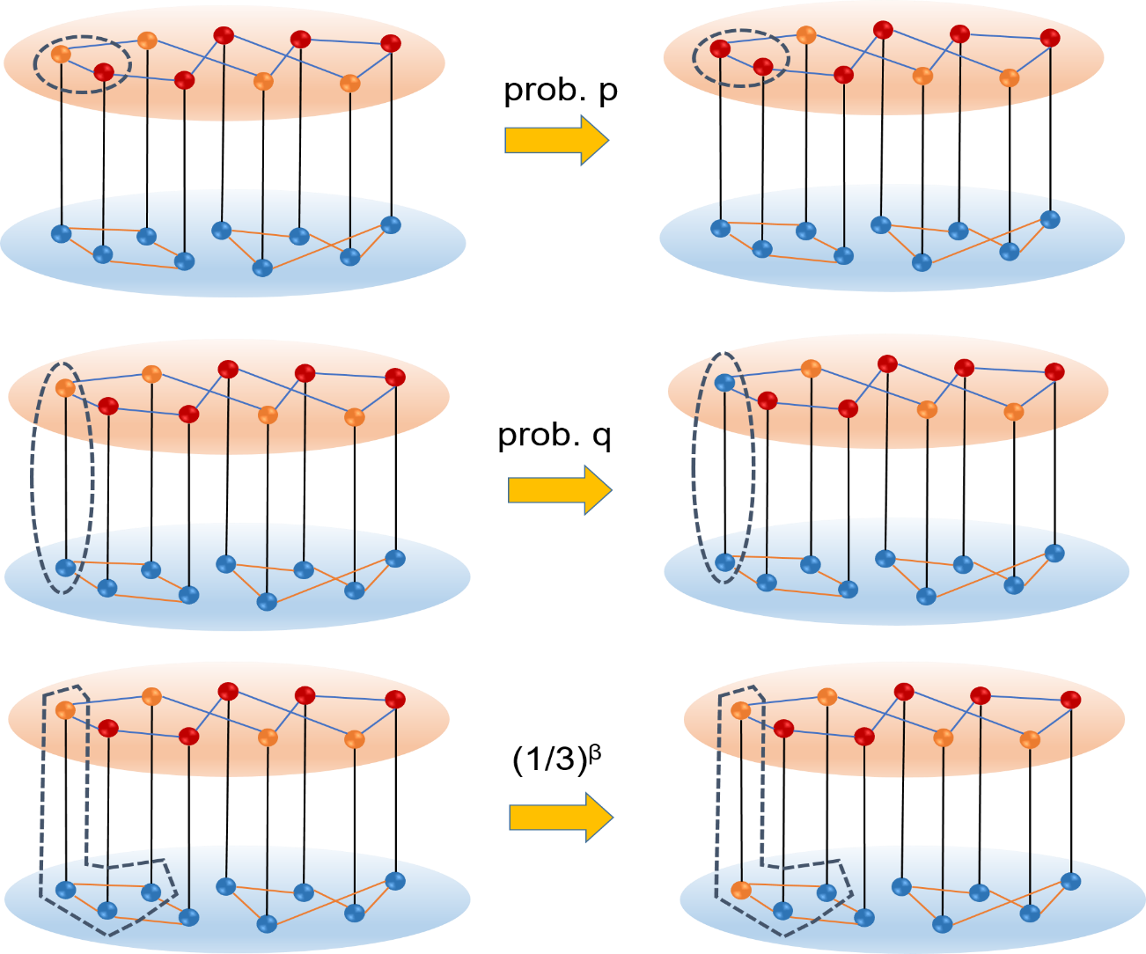

Model Introduction
Dynamics Algorithm for layer A
M-Model(The influence of persuasion in opinion formation and polarization)
persuasion(probability p) : same orientation, increasing intensity
persuasion(probability q) : opposite orientation, decreasing intensity
This model can have four states(-2, -1, +1, +2) that are changed by probability p and q
that is p + q = 1, γ = p / q
* Reinforcement(γ) : the tendency to keep orientation
Notes:
Next, I will provide the dynamics for each layer.
Dynamics Algorithm for layer A is like this. We use m-model. This model have various states. And the states are changed by probability p and probability q.
Probability p is for persuasion. That means the states become more extreme by probability p.
Probability q is for compromise. That means the states become more moderate or are changed into opposite state by probability q.
As dynamics parameter, We use reinforcement, gamma that consists of probability p and q. Gamma represents for the tendency to keep orientation.

Slide 9
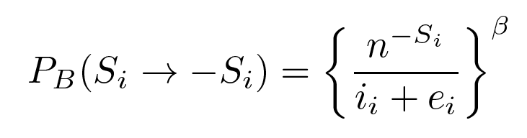
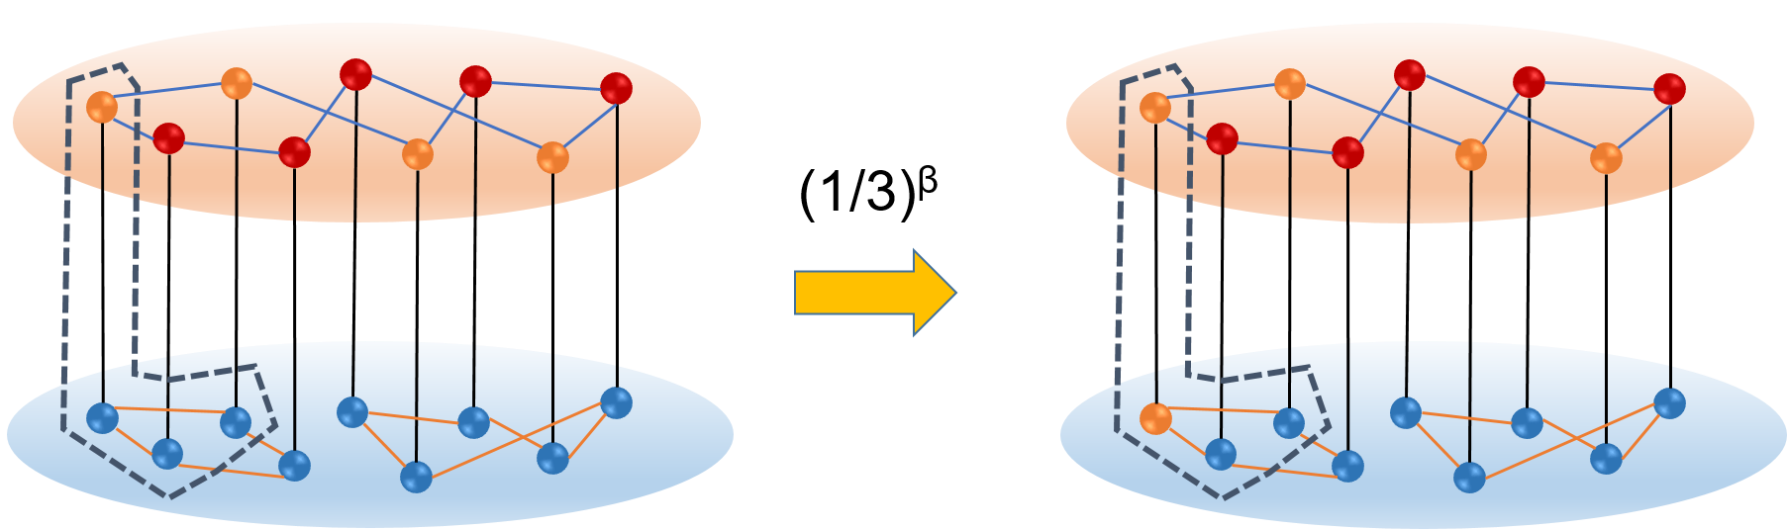
Model Introduction
Dynamics Algorithm for layer B
Abrams - Strogatz Model(Language Death Model / AS Model)
This model is only for binary state such as (+1, -1 ）or (1, 0）
* Volatility(β) : the tendency to switch to the other side
Notes:
Next, this is the dynamics algorithm for layer B. We use Abrams and Strogatz model that is known as language death model.
This model can have only binary states. And the states are changed by neighbor states. Among the neighbor nodes, the number of opposite node have influence on changing the state.
And as dynamics parameter, index beta works for volatility. Beta represents for the tendency to switch to the other side.
In this chart, there are 3 edges on this node. But the number of opposite node is just one. So the probability is one-third index beta.

Slide 10
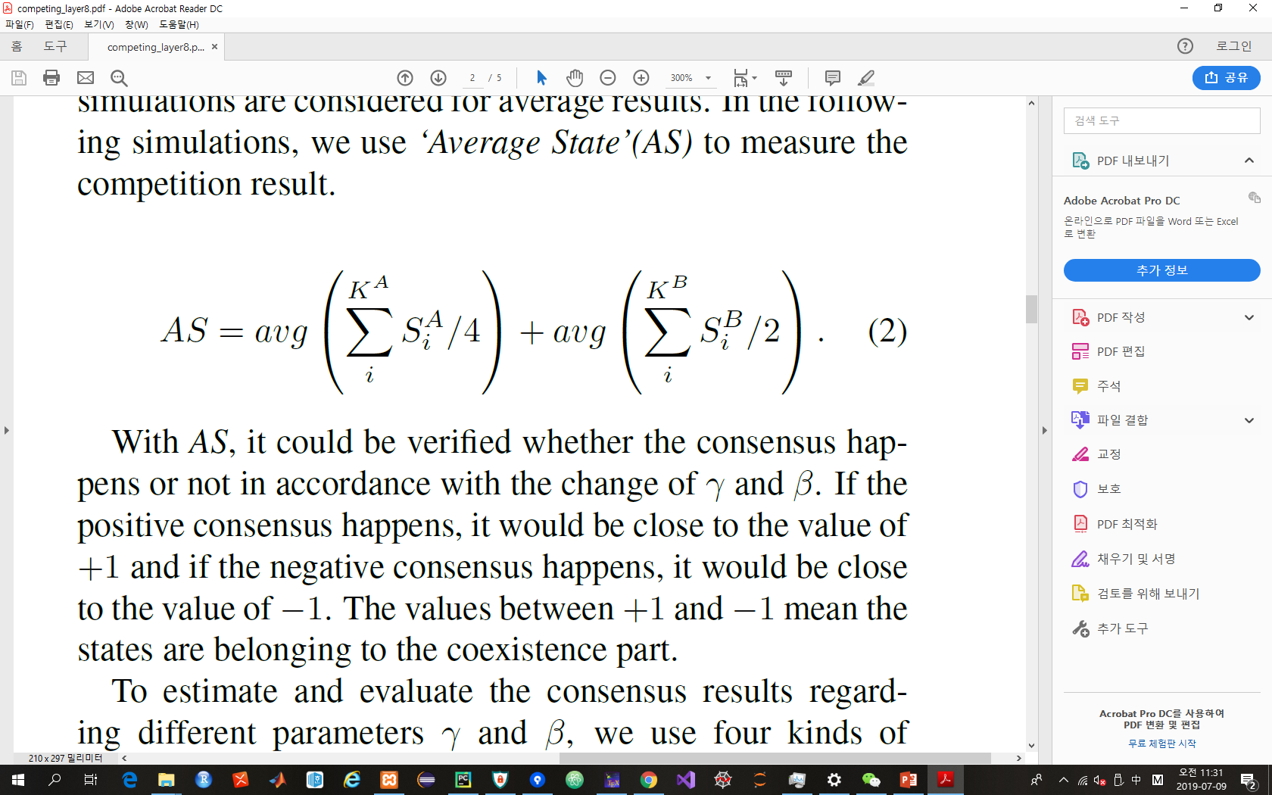
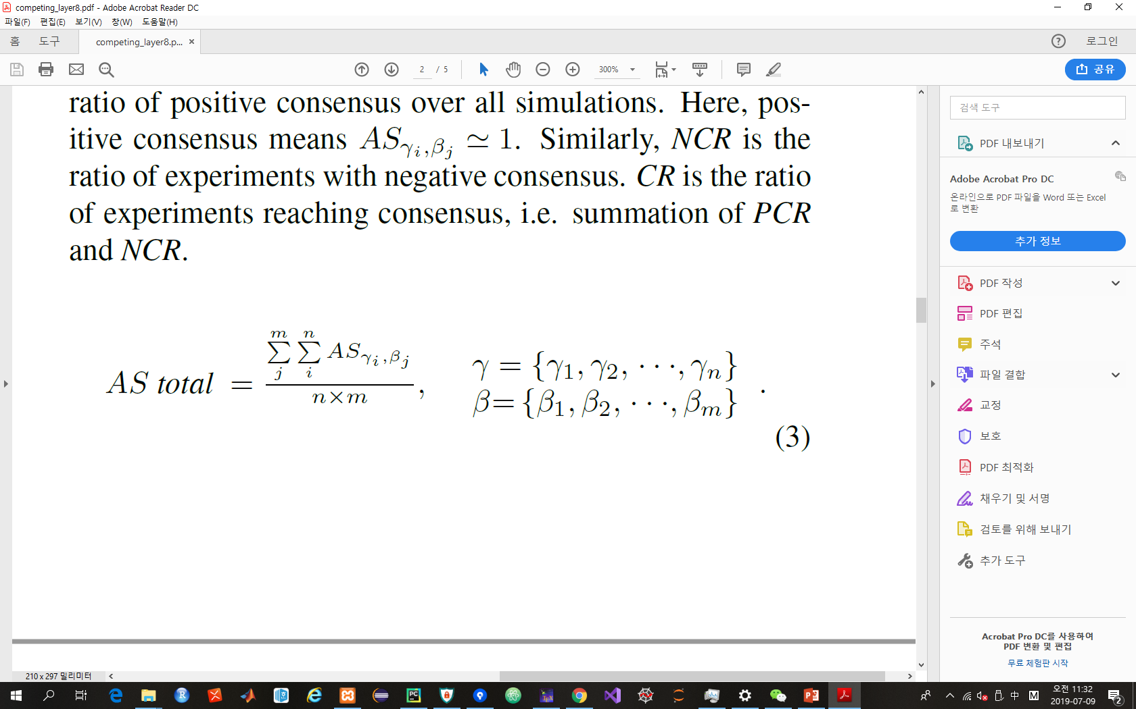
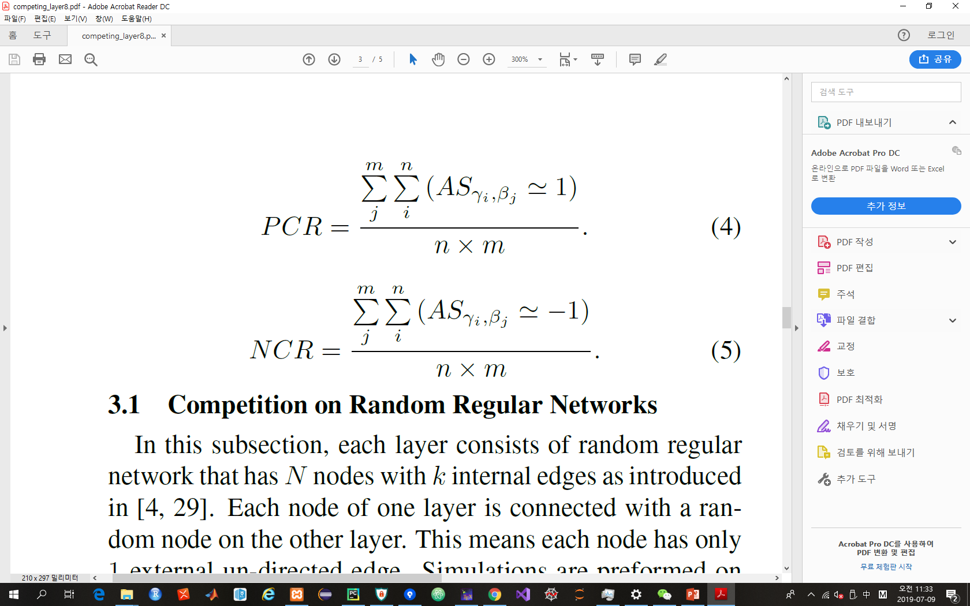
Model Introduction
Index for measuring consensus
- AS(Average State) : it could be verified whether the consensus happens or not.
AS ≈ +1 : positive consensus, AS ≈ -1 : negative consensus
- AS total : the summation of AS for all γs and all βs
- PCR(Positive Consensus Ratio) : the ratio of positive consensus over simulations
with all parameters
- NCR(Negative Consensus Ratio) : the ratio of negative consensus over simulations
with all parameters
Notes:
some indexes are provided for measuring consensus.
Average state could be verified whether the consensus happen or not.
As the AS is close to 1, positive consensus happen.
As the AS is close to -1, negative consensus happen.
AS total means the summation of AS for all parameters.
PCR represents the ratio of positive consensus over simulations with all parameters.
NCR represents the ratio of negative consensus over simulations with all parameters.

Slide 11
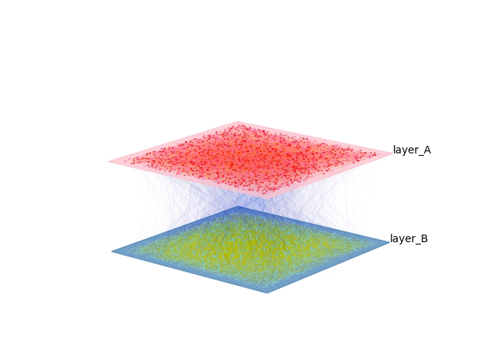
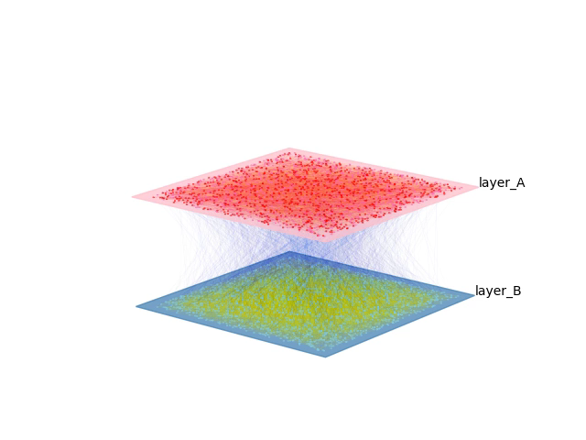
Model Introduction
Dynamics on network with two layers
Social opinion
Decision-making
Positive consensus
(γ : 0.67, β : 2.0)
Negative consensus
(γ : 0.25, β : 2.0)
Notes:
I will show you two animation of competition networks.
One is the dynamics that makes positive consensus.
The other is the dynamics that makes negative consensus.
Red and pink is for positive state. And blue and light blue is for negative state.
We suppose that layer A stands for social opinion and layer B stands for decision making. As initial states, social opinions are opposite to decision making layer.
I will show you.

Slide 12
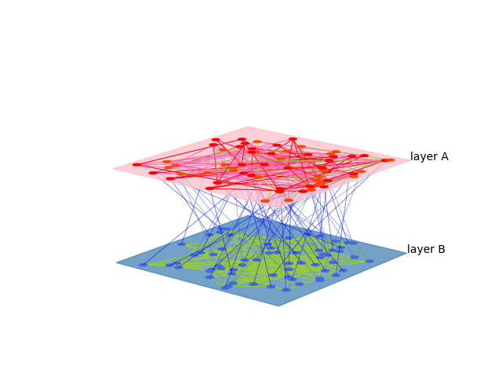
Simulation Results
Competition on Random Regular(RR) Networks
Each layer consists of random regular network that has 2048 nodes.
Each node has 5 internal edges and 1 external edge.
This competition is basic model for comparison.
Based on this model, the structures of model would be changed and modified.
Notes:
This is for simulation result of competition on Random Regular networks.
Each layer consists of random regular network that has 2048 nodes. And each node has 5 internal edges and 1 external edge.
This model is simulated as basic model.

Slide 13
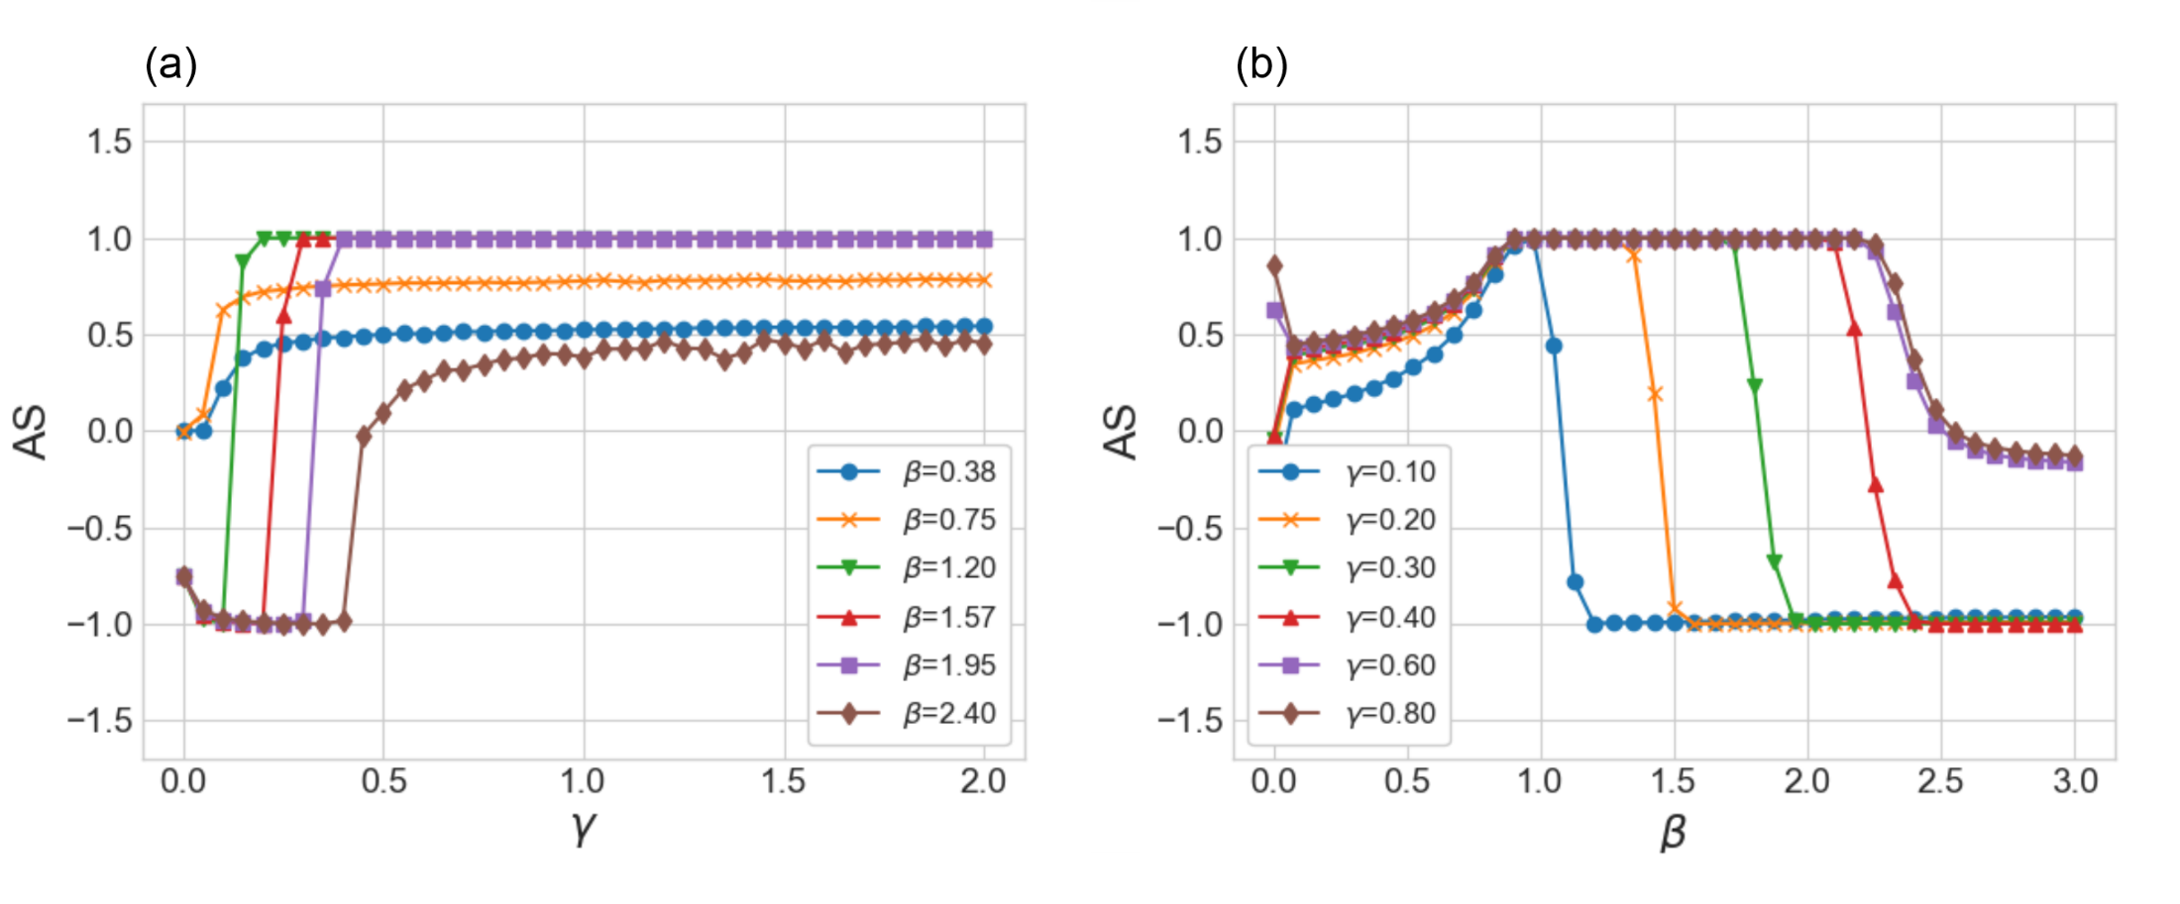
Simulation Results
Competition on Random Regular(RR) Networks
- As γ increases, it normally makes positive consensus(when 1.20 < β < 1.95)
- As β increases, it normally makes negative consensus.(when γ < 0.6)
- When β is very small, it doesn’t make consensus.
→ γ helps positive consensus, β helps negative consensus.
Notes:
This figure shows several facts.
- As γ increases, it normally makes positive consensus.
- As β increases, it normally makes negative consensus.
- When β is very small, it doesn’t make consensus.
That means gamma help positive consensus, and beta help negative consensus.
But small beta make coexistence part. Large gamma and large beta make coexistence part.

Slide 14
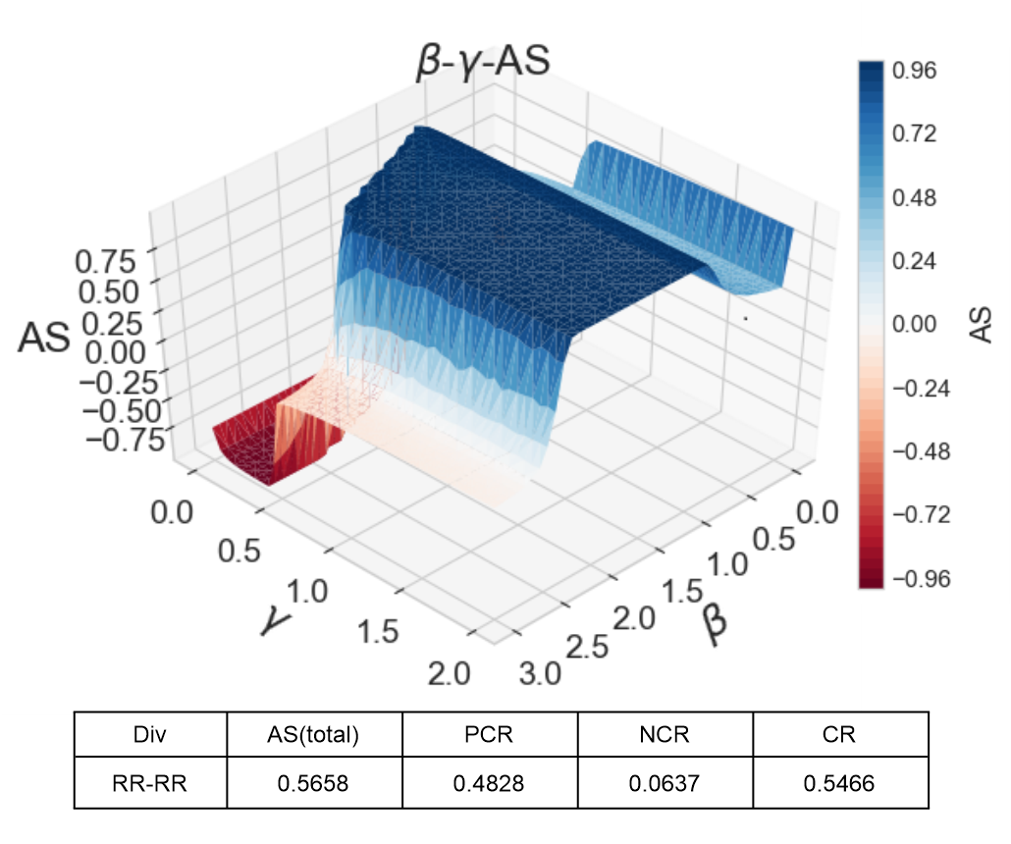
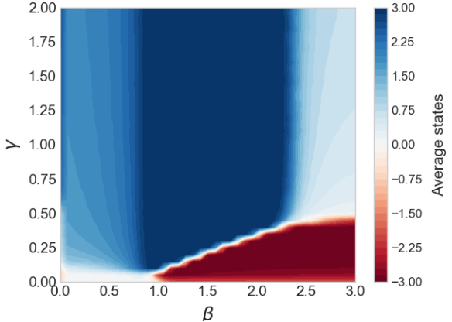
Simulation Results
Competition on Random Regular(RR) Networks
Simulation results with all parameters(γ, β)
Blue : positive consensus / Red : Negative consensus / Light and white : coexistence
There are three states(positive consensus, negative consensus, coexistence)
With this area of consensus, we would compare with other structural models
Notes:
These figures shows the states of two layers according to all parameters. X-axis is beta and Y -axis is gamma , and
Z-axis represents AS. The closer the color is to blue, the more it has positive consensus. And the closer the color is to
red, the more it has negative consensus. A light and white areas have coexistence with positive states and negative states.
As we can see, there are 3 states, positive, negative and coexistence.
In here, AS total means summation of these values. PCR means blue area. NCR means red area.
With this area of consensus, we would compare with other structural models.

Slide 15
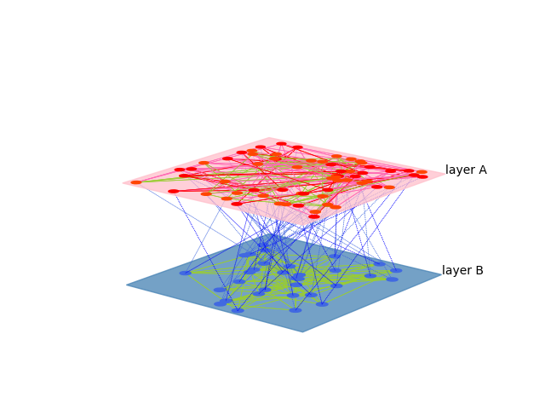
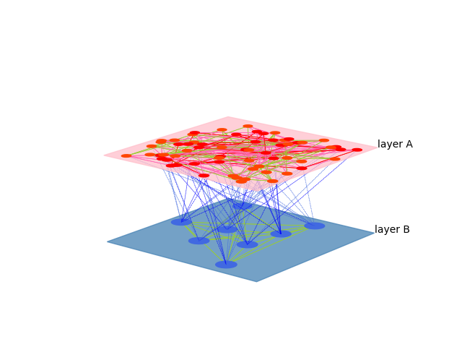
Simulation Results
Competition on Networks with different number of external links
HM(2) : Each node in layer B has 2 external edges
HM(8) : Each node in layer B has 8 external edges
We denote HM(n) as a hierarchical model with a level n, which means that the number of nodes in layer B is 1 / n of the number of nodes in layer A, and the number of external links from node in layer B is n
Notes:
Next simulation is for competition on networks with different number of external links.
we reduce the number of nodes in layer B at a certain rate and increase
the external links from nodes in layer B accordingly. This model is denoted as a hierarchical model with a level n.
N means the number of external edges as well as reducing ratio of nodes in layer B.
As we can see these figure, in layer B, HM(2) means the number of nodes is reduced by 1/2, and each node has 2 external edges.
HM(8) means the number of nodes is reduced by 1/8, and each node has 8 external edges.

Slide 16
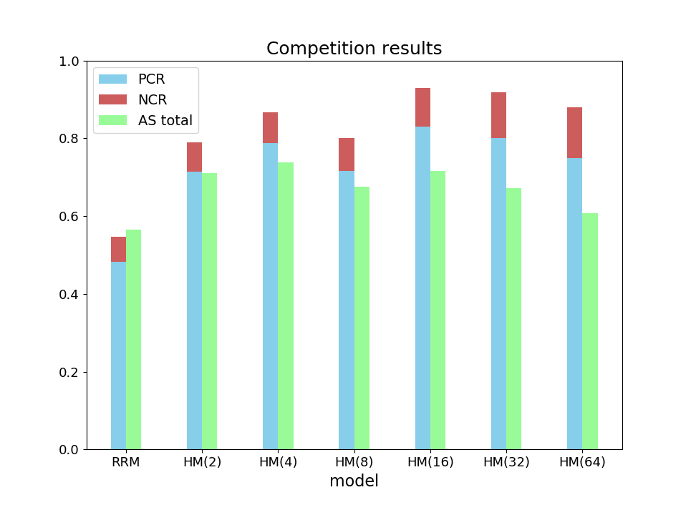
Simulation Results
Competition on Networks with different number of external links
Consensus : all HMs > RRM
Consensus Area :
Least negative consensus Area : HM(2)
Most negative consensus Area : HM(64)
→ As the number of external edges is
increased, NCR is also increased.
* Too many external edges make
more negative consensus.
Notes:
Hierarchical model simulation result is like this.
PCR is the blue part, and NCR is the red part.
As we can see the results, all hierarchical models have more consensus parts than random regular models.

Slide 17
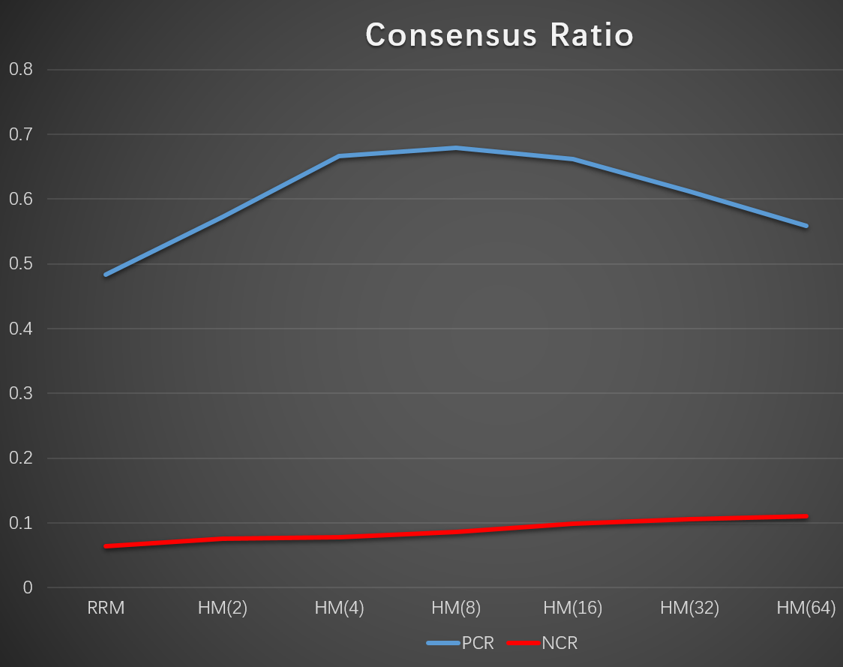
Simulation Results
Competition on Networks with different number of external links
Consensus : all HMs > RRM
Consensus Area :
Least negative consensus Area : HM(2)
Most negative consensus Area : HM(64)
→ As the number of external edges is
increased, NCR is also increased.
* Too many external edges make
more negative consensus.
Notes:
In this chart, blue line is for PCR, red line is for NCR.
PCR line is curved at HM(8), And NCR line is on the rise.
In consensus area, HM(2) has the least part of negative consensus. HM(64) has the most part of negative consensus.
Here, we can find out that as the number of external edges is increased, NCR is also increased.
So to speak, too many external edges make more negative consensus.

Slide 18
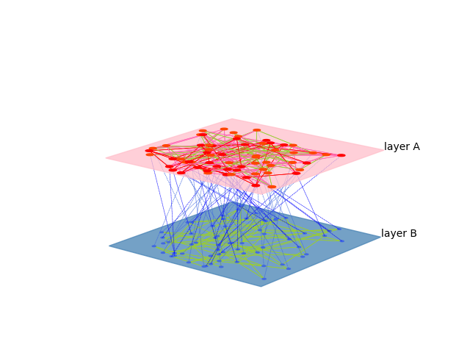
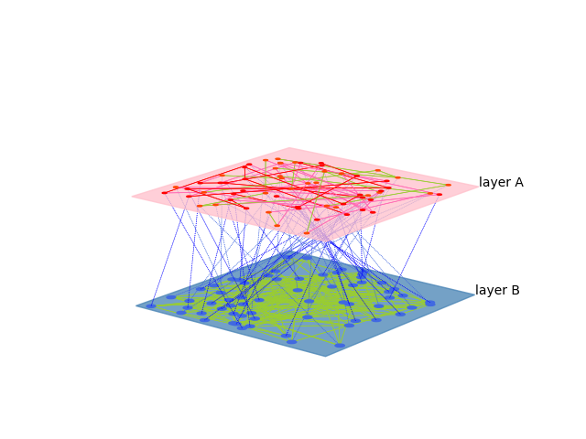
Simulation Results
Competition on Networks with different number of internal links
RR(5)-RR(2)
RR(2)-RR(5)
To define and evaluate the influence of internal degrees,
the number of internal degrees on each node is switched to 2 or 5.
Notes:
Next simulation is for competition on networks with different number of internal links.
As you can see these figure, to evaluate the influence of internal degrees, the number of internal degrees on each node is switched to 2 or 5.

Slide 19
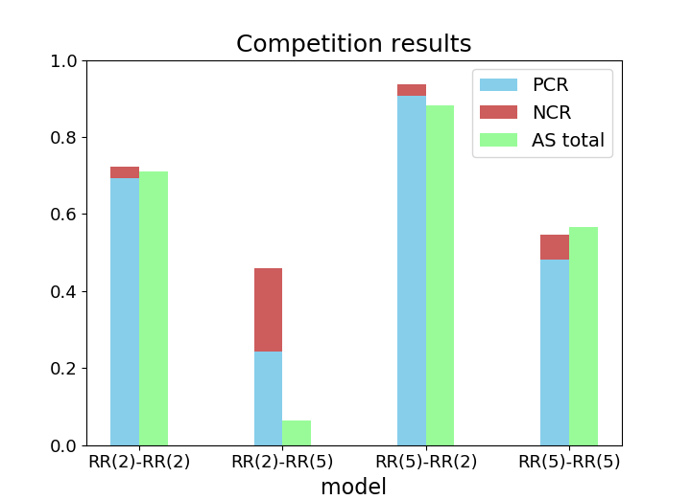
Simulation Results
Competition on Networks with different number of internal links
Consensus Area :
Most positive consensus Area : RR(5)-RR(2)
Most negative consensus Area : RR(2)-RR(5)
→ Edges of layer A > Edges of layer B :
Positive consensus increased
Edges of layer A < Edges of layer B :
Positive consensus decreased
The layer with more internal edges has
the tendency to maintain its own state.
Notes:
This figure shows the simulation results with changing the number of internal edges. RR(5)-RR(2) has the most PCR.
RR(2)-RR(5) has the most NCR. When the number of internal edges in layer A are more than layer B, it has more
positive consensus. On the other hand, when the number of internal edges in layer B are more than layer A, it has relatively
more negative consensus. These results provide that the number of edges on layer A has the tendency to keep positive
state, and the number of edges on layer B has the tendency to keep negative state. The number of internal edges
have the influence on consensus result and a layer with more
internal edges has the tendency to maintain its own state.

Slide 20
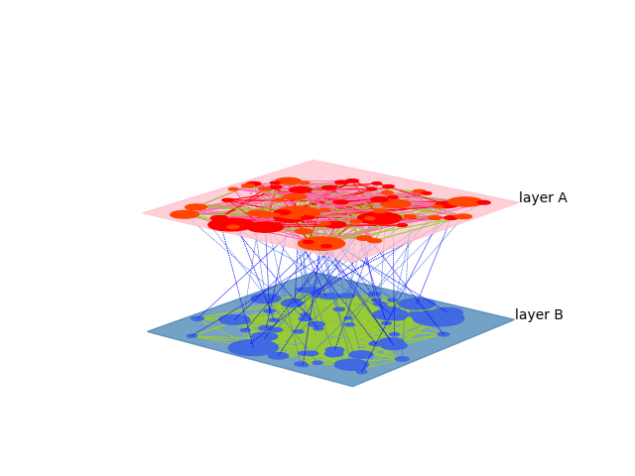
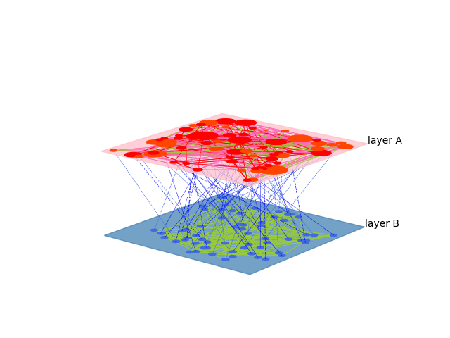
Simulation Results
Competition on Networks with different structures
BA-BA
BA-RR
To evaluate the influence of network structure,
the BA or RR network is applied for both layers or switched on each layer.
Notes:
Next simulation is for competition on networks with different structures.
As you can see figures, to evaluate the influence of structure, the BA or RR network is applied for both layers or switched on each layer.

Slide 21
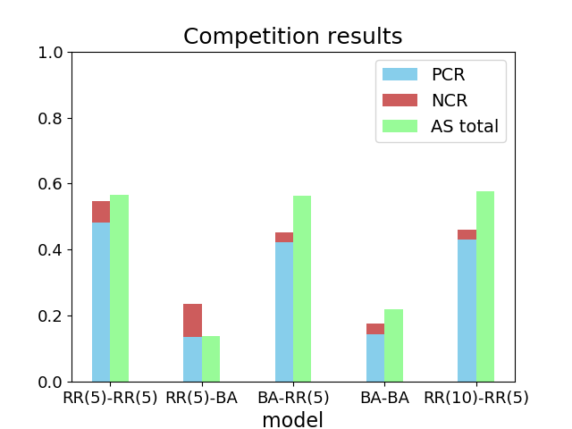
Simulation Results
Competition on Networks with different structures
consensus result :
Structures | A edges | B edges | Consensus (P : N)
RR(5)-RR(5) | 5,120 | 5,120 | 0.48 : 0.06
RR(5)-BA | 5,120 | 10,215 | 0.12 : 0.08
BA-RR(5) | 10,215 | 5,120 | 0.42 : 0.02
BA-BA | 10,215 | 10,215 | 0.13 : 0.02
RR(10)-RR(5) | 10,240 | 5,120 | 0.43 : 0.02
RR(10)-RR(5) ≈ BA-RR(5)
BA-BA : smallest consensus area(inner conflict)
The structure of network makes no obvious
difference of consensus results
The internal edges is more influential
Notes:
5 simulations are implemented with changing network structures.
Among these results, RR(10)-RR(5) has similar consensus result with BA-RR(5).
That means consensus result is more relative to the number of edges.
And BA-BA, which have the most internal edges, has the smallest consensus area.
That means too many internal edges make it hard to reach consensus due to inner conflict on each layer.
The structure of network makes no obvious difference of consensus results.
And the internal edges are more influential.

Slide 22
Conclusion
Summary
- External edges
① All the HMs have more consensus ratio than RRM.
→ When the number of B nodes are less and the number of external edges are more,
it is easy to make positive consensus.
② Too many external edges and small number of nodes in layer B are not good for
positive consensus.
- Internal edges
① The layer with more internal edges has more tendency to keep its own states.
② Too many internal edges on each layer can cause inner conflict, which makes
it hard to reach consensus.
- Structures
① The structure of network make no obvious difference of consensus results.
② The number of edges are more influential for consensus.
Notes:
Conclusion
If summarizing the simulation results, we have three main conclusion.
First, in external edges, all the hierarchical models have more consensus ratio than random regular model.
That means when the number of B nodes are less and the number of external edges are more, it is easy to make positive consensus.
And we can find out too many external edges and small number of nodes in layer B are not good for positive consensus.
Second, in internal edges, the layer with more internal edges has more tendency to keep its own states.
And, too many internal edges on each layer can cause inner conflict, which makes it hard to reach consensus.
Third, in structures, it make no obvious difference of consensus results. We can find out the number of edges are more
Influential for consensus.

Slide 23
Thank you
Notes:
Thank you.

Slide 24
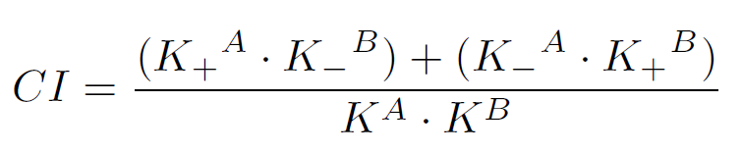
Simulation Results
Index for measuring consensus
CI (Consensus Index) : measuring how close the network state is to consensus.
CI ≈ 0 : consensus,
CI ≈ 1 : separated coexistence
(where states of all nodes in layer A is opposed to states of all nodes in layer B)
CI ≈ 0.5 : mixed coexistence
(where each layer has both positive and negative states of nodes)
Notes:
CI could measure how close the network state is to consensus.
As CI is close to 0, positive or negative consensus happens.
As CI is close to 1, the state is on separated coexistence.
As CI is close to 0.5, the state is on mixed coexistence.

Slide 25
Simulation Results
Competition on Random Regular(RR) Networks
Notes:
Next, I will give you some result from pre-existed research.
There are some critical points that make positive or negative consensus. So the critical points are found out with changing parameter gamma and beta.
So, network states are divided into positive consensus and negative consensus by critical points like gamma star and beta star.

